Slide 1
Hiring Process Analytics
Presented by: Mannat Sandhu

Slide 2
Introduction
Hiring process is the fundamental and the most important function of a company.
Trends such as- number of rejections, number of interviews, types of jobs, vacancies etc. are important for a company to analyse before hiring fresher’s or any other individual.
Being a Data Analyst, your job is to go through these trends and draw insights out of it for hiring department to work upon.

Slide 3


Tech Stack used
While working on this assignment, microsoft office is used.
Microsoft excel is used of performing operations.
Microsoft PowerPoint is used for result presentation.

Slide 4
Approach
Download the provided dataset.
Understand the data columns and data
Check for missing data and outliers.
Removing outliers
Understand the questions provided along the data.
Start to perform analysis on data using excel functions and pivot tables.

Slide 5
Questions
Hiring: How many males and females are Hired ?
Average Salary: What is the average salary offered in this company ?
Class Intervals: Draw the class intervals for salary in the company ?
Charts and Plots: Draw graph to show proportion of people working in different department ?
Charts: Represent different post tiers using chart/graph?

Slide 6
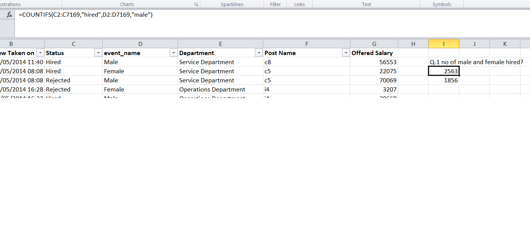
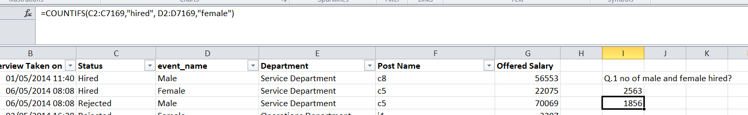
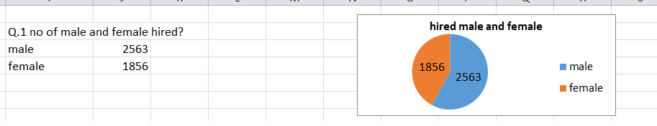
Hiring:
No of males and females hired is searched using countifs function and chart is formed from results.

Slide 7
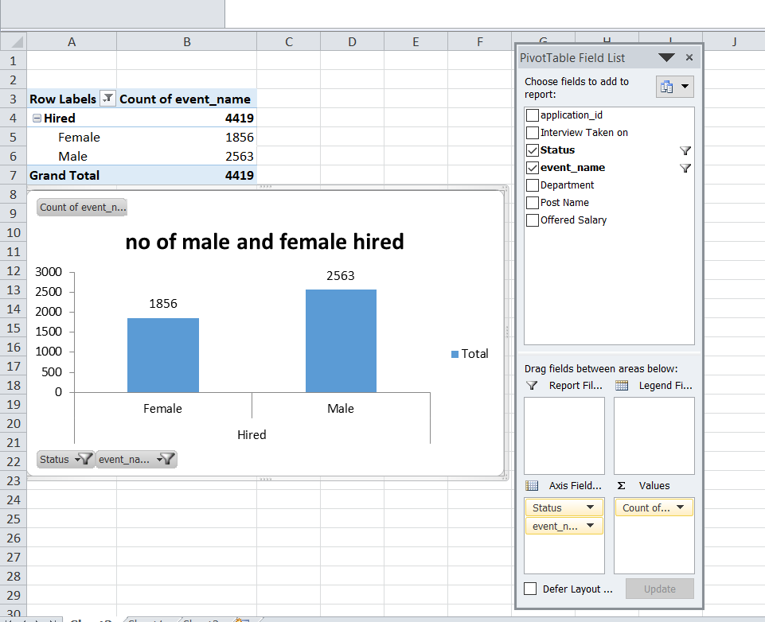
No of males and females hired is found using pivot table.

Slide 8
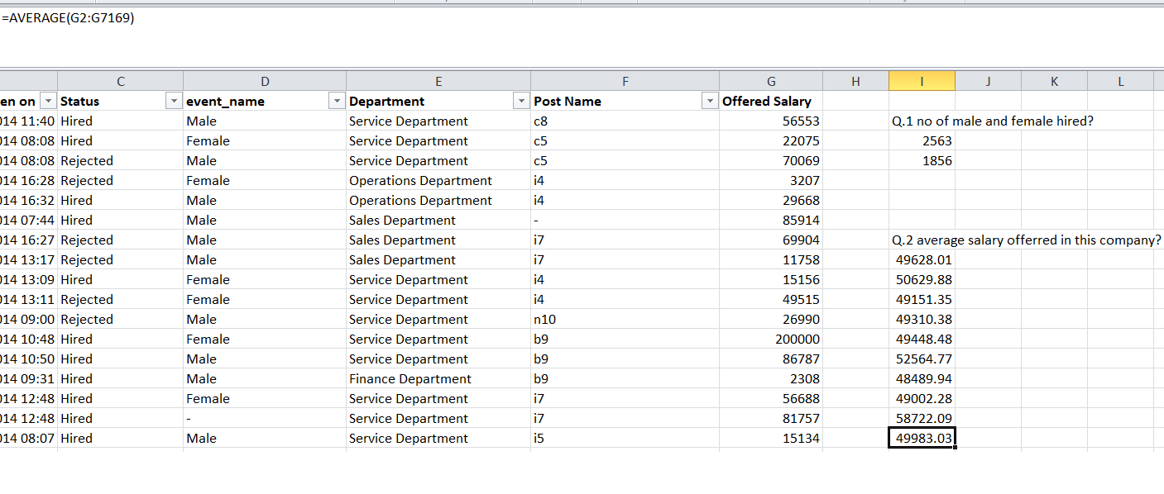
Average Salary:
Total average salary and department wise average salary is obtained using average and averageif functions respectively.

Slide 9
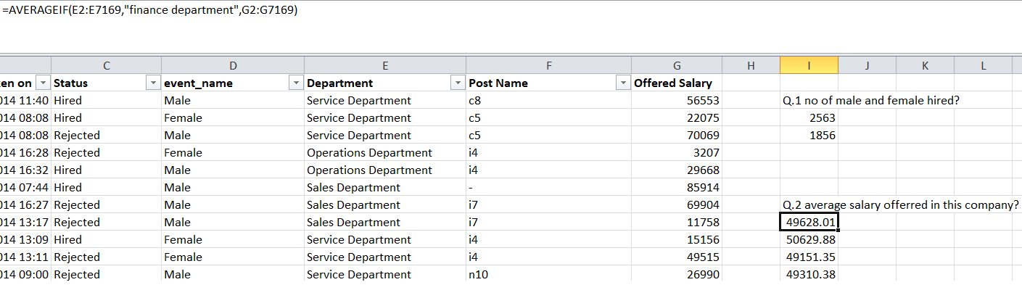
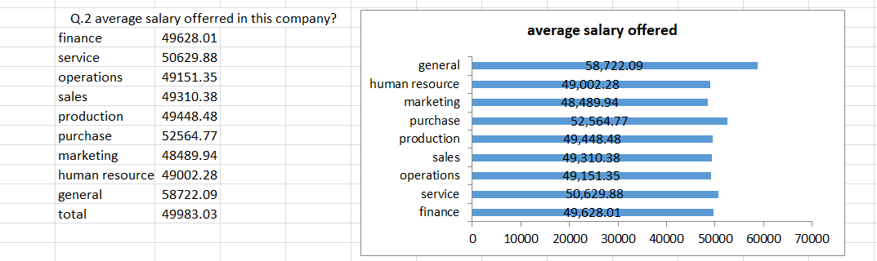

Slide 10
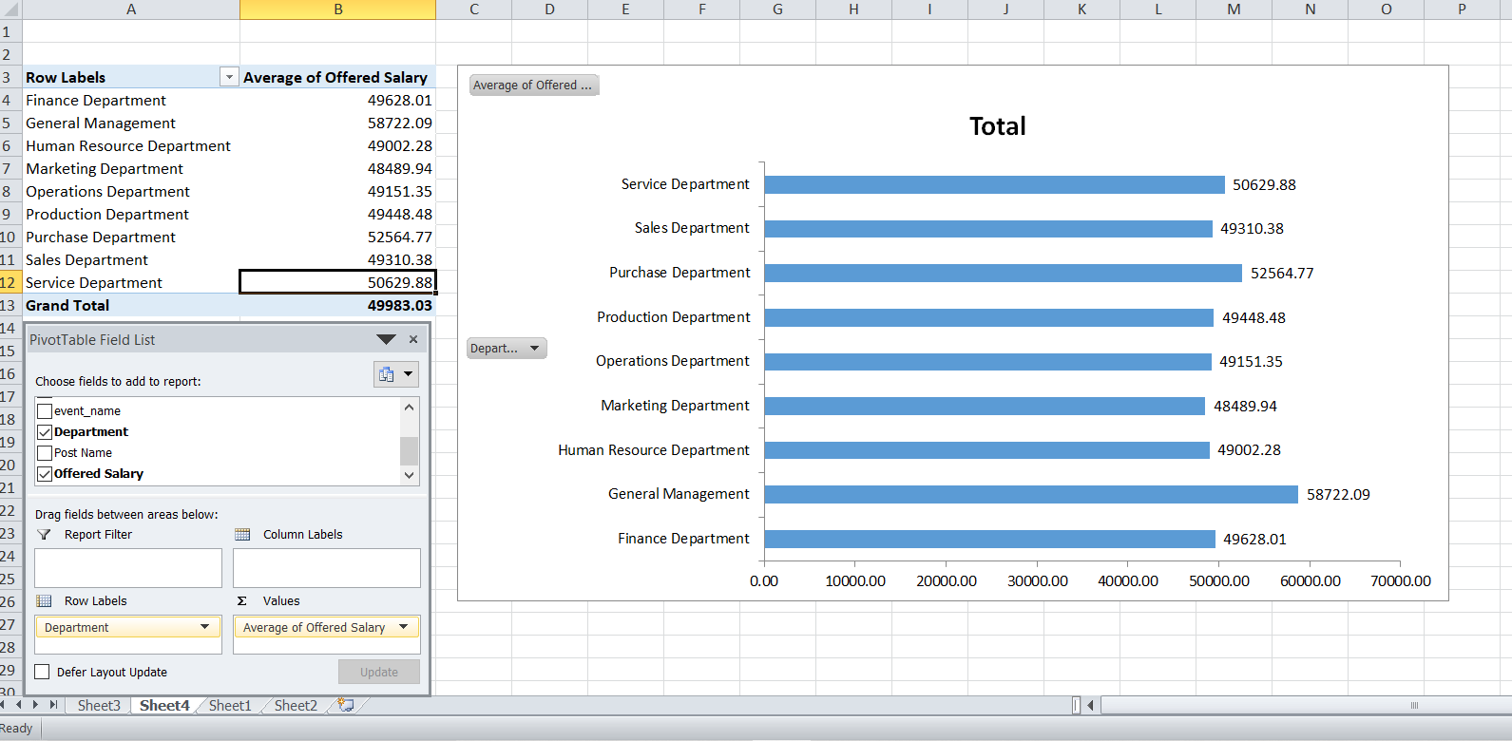
Results using pivot table.

Slide 11
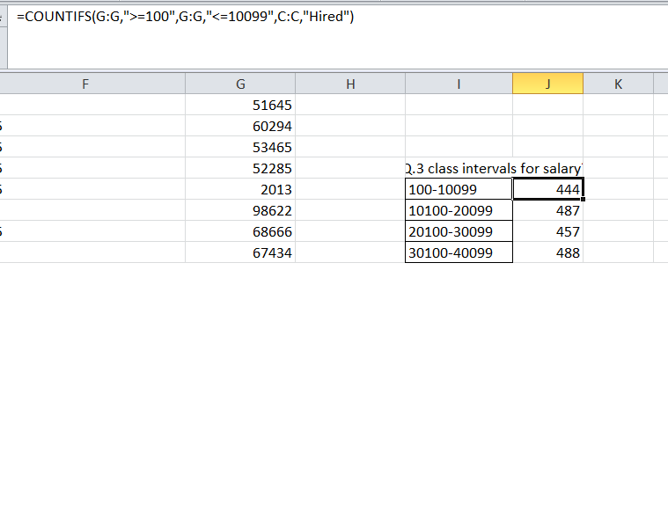
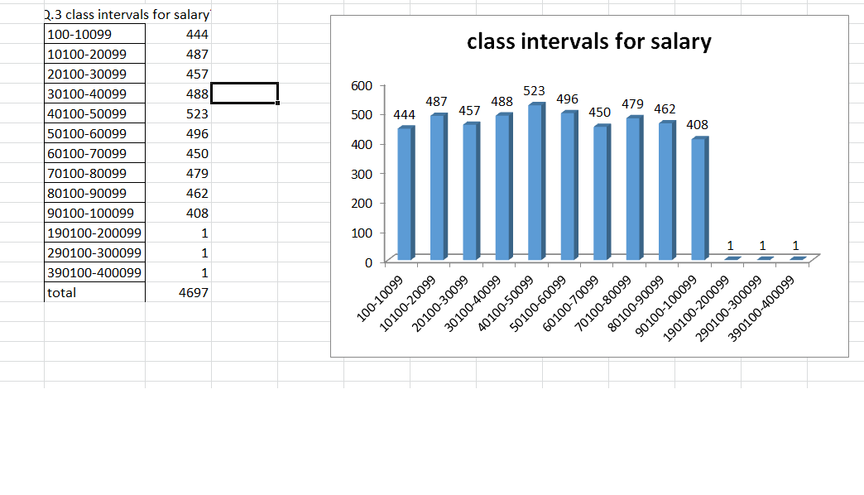
Class Intervals:
Results are obtained using countifs function.

Slide 12
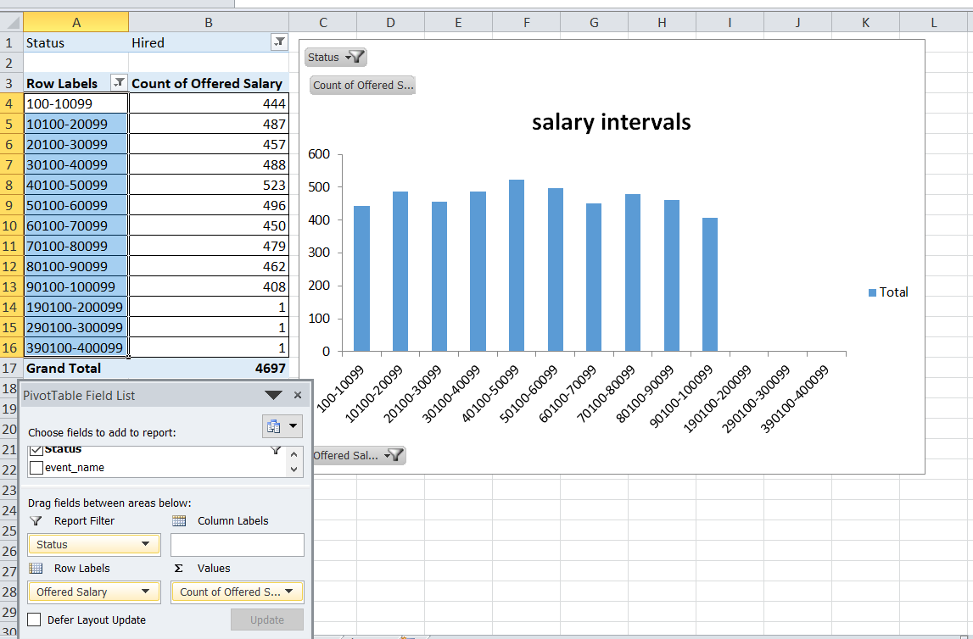
Results using pivot tables.

Slide 13
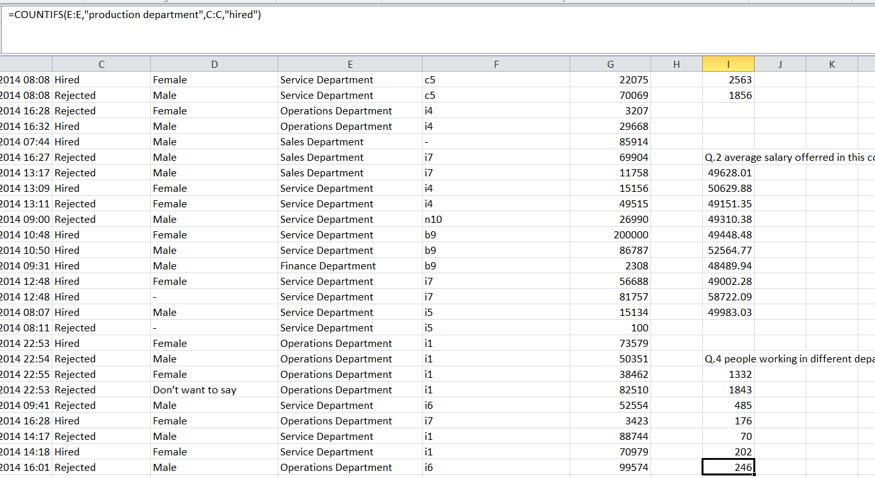
Charts and Plots:
Results are obtained using countifs and percentage functions

Slide 14
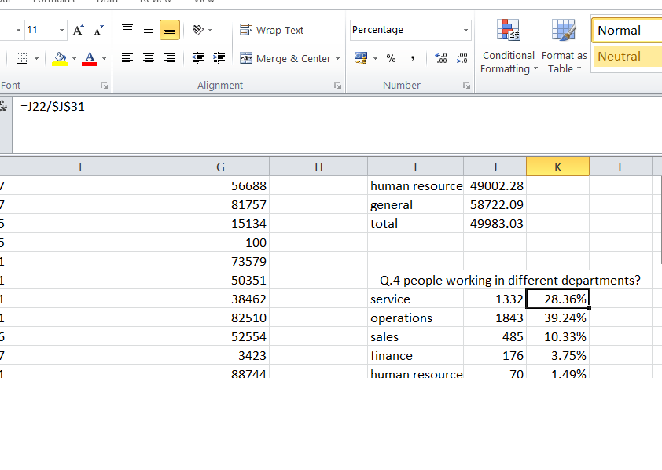
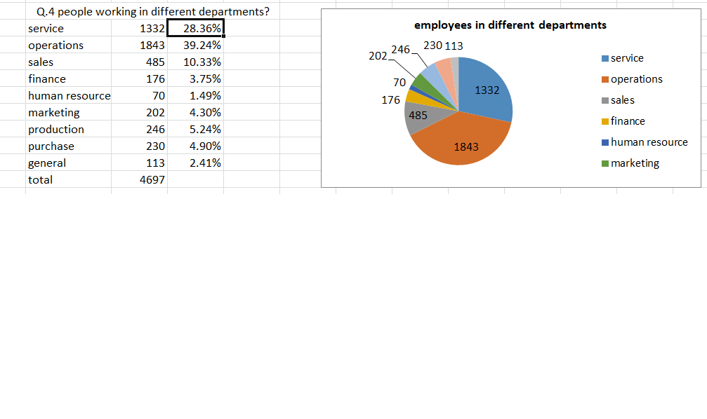

Slide 15
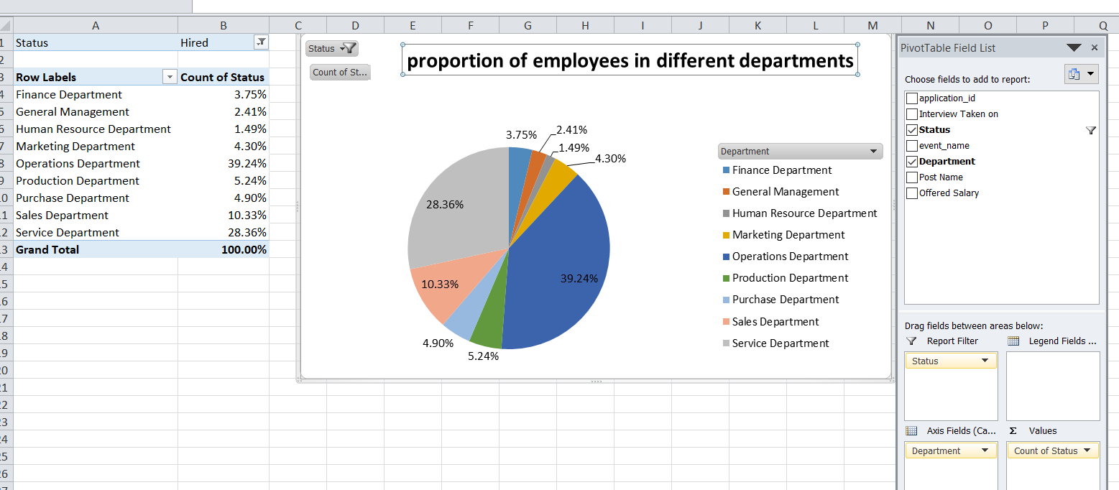
Using pivot tables.

Slide 16
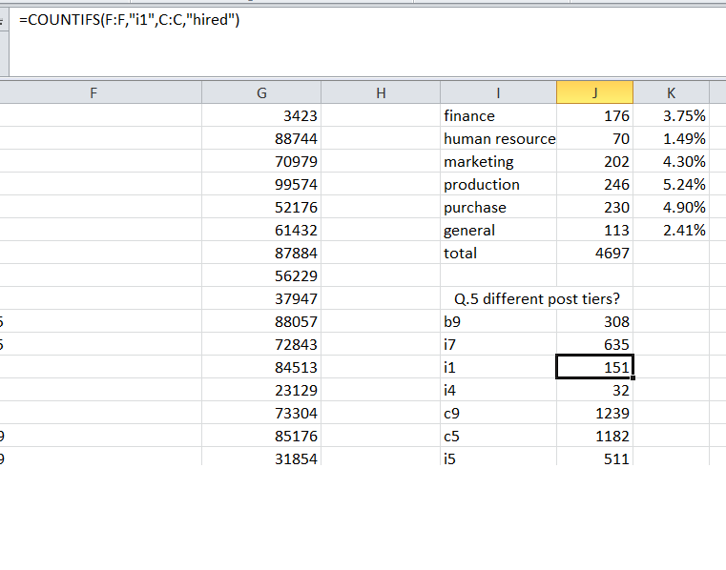
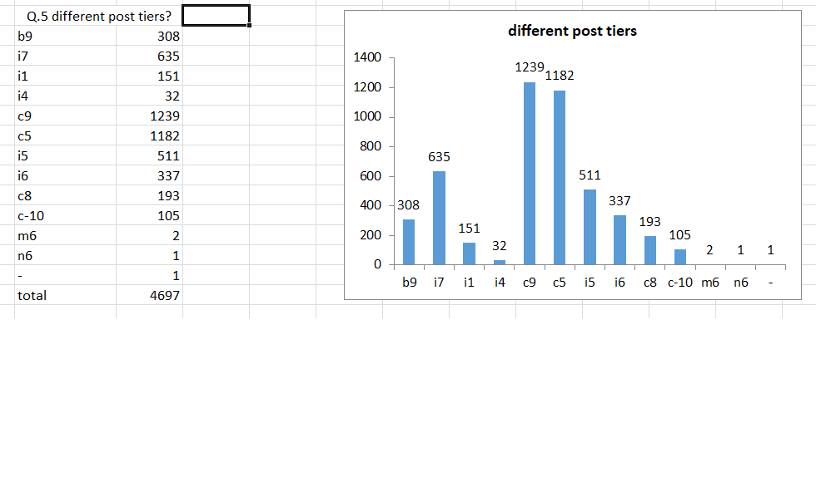
Charts:
Results are obtained using countifs function.

Slide 17
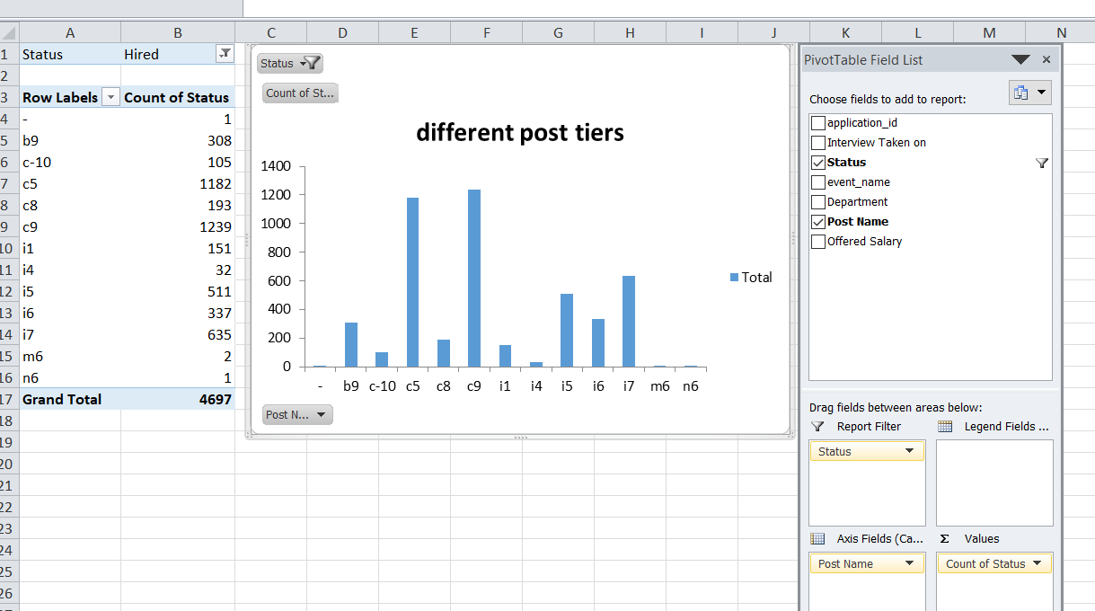
Pivot tables results.

Slide 18
Results
The outputs are achieved using excel functions and formulas and pivot tables. The graphs and charts are obtained using pivot as well as excel.
Through the result we understand the hiring process, count of people hired, average salary provided and proportion of employees working in various departments and tiers.
It also revealed the salary limits and differences in upper and lower salaries.

Slide 19
Thank You

